Slide 1
GRAPHS
An Introduction
by
Lilian Blot
Notes:
Today we are looking at Graphs, an important data structure in the computer scientist arsenal. Graphs are important because they can be used to represent essentially any relationship between entities, like a rail network, representing cities connected to other cities by a direct line.
During the video, we will be covering some definitions and describe different types of graphs.
Finally we will be looking at how to represent them from a computer science point of view.

Slide 2

A graph $G=(V,E)$ consists of a set of vertices $V$ together with a set of edges $E$.
An edge connects two vertices together
An empty graph is a graph where $V=∅$ and $E=∅$
A
Vertices
B
D
C
edges
F
E
Notes:
First let’s define what a graph is. A graph $G=(V,E)$ consists of a set of vertices $V$ together with a set of edges $E$. An edge connects two vertices together.
An edge represents some form of relationship between two vertices.
An empty graph is a graph where the set of vertices V is empty, and therefore the set of edges E is also empty.

Slide 3
A vertex may not belong to any edge.
A
B
D
C
K
F
E
Notes:
Note that a vertex may not belong to any edges as shown by vertex K. For example K could represent a city on an island that is not connected to any other cities on the mainland via a railroad.

Slide 4
Graphs are dense when the number of edges is close to the maximal number of edges
A sparse graphs has few edges relative to its number of vertices.
A
A
B
D
B
D
C
E
F
C
E
F
Notes:
Graphs have many properties, and we will express them when and where they are needed. In this video, we need to define three properties related to the number of edges in a graph.
A Graphs is said to be dense when the number of its edges is close to the maximal number of edges, that is of the order of the number of its vertices to the square |V|^2.
On the opposite spectrum, a sparse graphs has few edges relative to its number of vertices. Usually of the order of the number of its vertices
A complete graph is a graph in which each pair of vertices is joined by an edge. A complete graph contains all possible edges, and therefore is a dense graph. On the left hand side you can see an example of a complete graph composed of 6 vertices.

Slide 5

TYPES OF GRAPH
Notes:
There are many types of graphs and it is very important to be able to recognise them, in particular when you want to use an algorithm to solve a problem. You may need a different algorithm to solve the same problem depending on the type of graph.

Slide 6

UNDIRECTED GRAPHS
An undirected graph is a graph in which edges have no orientation. That is, the edge $(u,v)$ is identical to the edge $(v,u)$.
A
D
C
F
B
E
Notes:
The first type of graph is an undirected graph. An undirected graph is a graph in which the edges have no orientation or direction. That is, the edge $(u,v)$ is identical to the edge $(v,u)$. It means that if a node u is in relation with node v, v is also in relation with node u. It is the simplest type of graph.
An example of such graphs is a social network. Nodes are people and edges represent bidirectional relationship between people, like being friends. Study of social networks founds application in many disciplines, such as sociology, economics, biology and counter terrorism.

Slide 7

DIRECTED GRAPHS
An directed graph (also known as a Digraph) is a graph in which edges have orientations. For example, the edge $(u,v)$ is the edge from node $u$ to node $v$.
A
D
C
F
B
E
Notes:
In contrast, An directed graph (also known as a Digraph) is a graph in which edges have orientations. In this case, edges are represented by an arrow. When considering the edge from u to v, I will use the terms source, origin or tail to refer to the node u, and target, destination or head to refer to the node v.

Slide 8

DIRECTED GRAPHS
An directed graph (also known as a Digraph) is a graph in which edges have orientations. For example, the edge $(u,v)$ is the edge from node $u$ to node $v$.
A
D
C
F
B
E
Note that given an edge $(u,v)$ the edge $(v,u)$ may or may not exist.
Notes:
Note that if a digraph has an edge $(u,v)$ ,the edge $(v,u)$ may or may not exist.
An Example of such graphs is a graph representing followers in social networks such as twitter. I may follow a person, such as an famous actor, however it is unlikely that this celebrity follows me back. This means that the relationship following is directed. Study of such graphs can be used to determine influencers within a group of people.
Another Example is the structure of a website containing many pages. Each page is considered a vertex, and an edge exists between the two vertices if the source page as a link to the target page.

Slide 9
WEIGHTED GRAPHS
A weighted graph is a graph in which edges contain a certain weight. The weights represent arbitrary values such as distance, cost, quantity, flow, etc…
A
4
D
6
2
4
3
C
5
F
B
2
13
E
9
Notes:
So far we have seen unweighted graphs, that is their edges have no associated weight. A weighted graph is a graph in which edges contain a certain weight. The weights represent arbitrary values such as distance, cost, quantity, flow, etc…
For example the graph shown could represent cities connected by railroad, and the weights are the distances between cities.

Slide 10

WEIGHTED GRAPHS
Weighted graph can be directed or undirected. Edges in weighted graph can be denoted as triplet $(u,v,w)$.
1
A
D
3
2
4
8
C
4
F
5
B
6
E
4
Notes:
Weighted graph can be directed or undirected. Edges in weighted graph can be denoted as triplet $\left(u,v,w\right)$ where u is the source, v the target and w the associated weight.
Example of such graphs are Flow Networks where edges are pipes and nodes are intersections between pipes. Flow networks are also used for transportation problem, such as maximum traffic through roads, or analysis of bottleneck in production factory with various workshops or tools.
Usually weights are strictly positive, however in some cases they might be negative. A negative weight could represent the energy used to go from state A to B, whereas a positive weight represent the energy produced to go from state B to A.

Slide 11

WEIGHTED GRAPHS
Weighted graph can be directed or undirected. Edges in weighted graph can be denoted as triplet $(u,v,w)$.
1
A
D
3
2
4
8
C
4
F
5
B
6
E
4
Note that in a digraph, the weight for the edge $(u,v)$ may differ from the weight of edge $\left(v,u\right).$
Notes:
In some digraph, the weight for the edge $(u,v)$ may differ from the weight of edge $\left(v,u\right).$ This is the case for the edges between nodes B and C. This could represent a road having four lanes going from B to C, and only three from C to B. This would allow more vehicles going from B to C in a given unit of time hence a higher weight.

Slide 12

REPRESENTING GRAPHS
Notes:
Now that we understand what a graph is, we need to address the issue of representing a graph on a computer. That is what data structure should we use to implement our graph.
Careful consideration should be taken as the choice of data structure can have a huge impact on the performance of some algorithm, as well as the readability of your code.

Slide 13

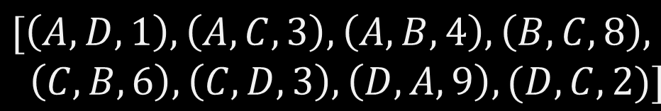
EDGE LIST
A very simple way to represent a graph is an edge list (or array of edge). For a weighted graph, it is a list of triplet $\left(u,v,w\right)$ containing the source $u$, the destination $v$ and the weight $w$ of an edge.
9
A
D
1
3
3
$$[\left(A,D,1\right),\left(A,C,3\right),\left(A,B,4\right),\left(B,C,8\right), \\ \left(C,B,6\right),\left(C,D,3\right),\left(D,A,9\right),(D,C,2)]$$
4
8
2
C
B
6
Notes:
The simplest representation is an edge list (or an array of edges). For a weighted graph, it is a list of triplet $\left(u,v,w\right)$ containing the source $u$, the destination $v$ and the weight $w$ of an edge. In our example, the edge from A to D is represented by the triplet (A,D,1). The main issue of this representation is the lack of structure. For example, to find the list of all nodes in the graph, we must traverse the list entirely.
Furthermore, what about nodes that are not connected to any other nodes? A solution to this problem is to have two lists, one for the edges and one for the nodes.

Slide 14
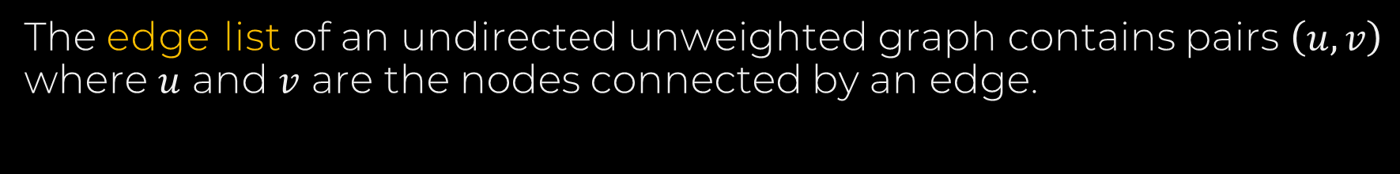
EDGE LIST
The edge list of an undirected unweighted graph contains pairs $\left(u,v\right)$ where $u$ and $v$ are the nodes connected by an edge.
A
B
D
$$[\left(A,D\right),\left(A,C\right),\left(A,B\right),\left(B,C\right),\left(C,D\right)]$$
C
Notes:
The edge list of an undirected unweighted graph contains pairs $\left(u,v\right)$ where $u$ and $v$ are the nodes connected by an edge. In this case, the edges (A,D) and (D,A) are both represented by the pair (A,D).
This graph implementation is rarely used due to its lack of structure.

Slide 15



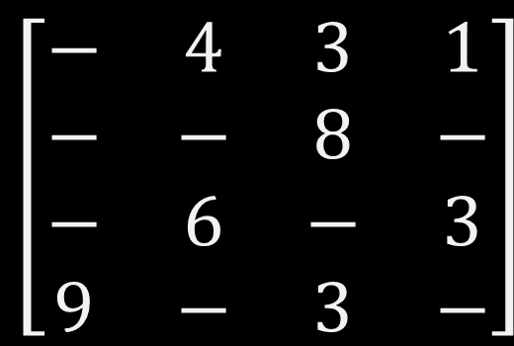
ADJACENCY MATRIX
An adjacency matrix $M$ is another simple way to represent a graph. The cell $M_{u,v}$ (also noted $M[u][v]$) represents the edge weight of going from node $u$ to node $v$.
9
$$\begin{matrix}A & B & C & D\end{matrix}$$
A
D
1
$$\begin{matrix}A \\ B \\ C \\ D\end{matrix}$$
$$\left[\begin{matrix}− & 4 & 3 & 1 \\ − & − & 8 & − \\ − & 6 & − & 3 \\ 9 & − & 3 & −\end{matrix}\right]$$
3
4
3
8
2
C
B
6
Notes:
Another simple way to represent a graph is an adjacency matrix. The cell $M_{u,v}$ (also noted $M[u][v]$)represents the edge weight of going from node $u$ to node $v$.
The rows are the source node, and the columns are the target node.

Slide 16
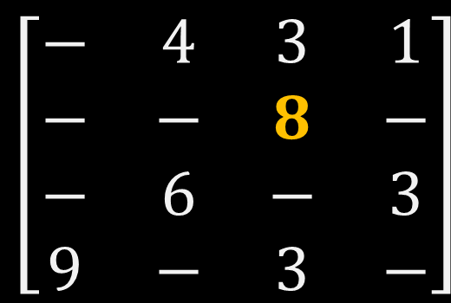
ADJACENCY MATRIX
An adjacency matrix $M$ is another simple way to represent a graph. The cell $M_{u,v}$ (also noted $M[u][v]$) represents the edge weight of going from node $u$ to node $v$.
9
$$\begin{matrix}A & B & C & D\end{matrix}$$
A
D
1
$$\begin{matrix}A \\ B \\ C \\ D\end{matrix}$$
$$\left[\begin{matrix}− & 4 & 3 & 1 \\ − & − & 8 & − \\ − & 6 & − & 3 \\ 9 & − & 3 & −\end{matrix}\right]$$
3
4
3
8
2
C
B
6
Notes:
For example, the weight 8 of the edge (B,C) is stored in the cell at the intersection of the second row and third column.
You may have noticed that so far I did not put a value in the cells when the corresponding edge does not exist.

Slide 17
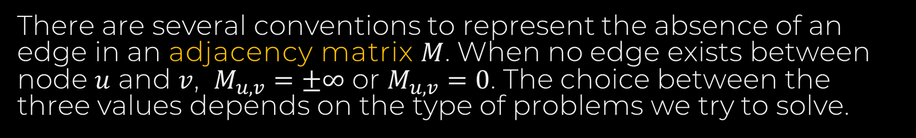

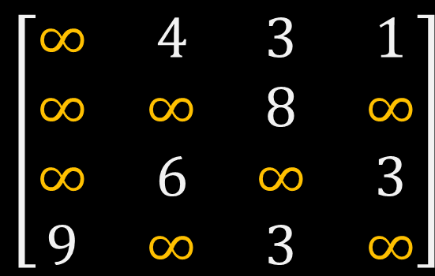
ADJACENCY MATRIX
There are several conventions to represent the absence of an edge in an adjacency matrix $M$. When no edge exists between node $u$ and $v$, $M_{u,v}=±∞$ or $M_{u,v}=0$. The choice between the three values depends on the type of problems we try to solve.
9
$$\begin{matrix}A & B & C & D\end{matrix}$$
A
D
1
$$\begin{matrix}A \\ B \\ C \\ D\end{matrix}$$
$$\left[\begin{matrix}∞ & 4 & 3 & 1 \\ ∞ & ∞ & 8 & ∞ \\ ∞ & 6 & ∞ & 3 \\ 9 & ∞ & 3 & ∞\end{matrix}\right]$$
3
4
3
8
2
C
B
6
Notes:
There are several conventions to represent the absence of an edge in an adjacency matrix $M$. When no edge exists between node $u$ and $v$, $M_{u,v}=±∞$ or $M_{u,v}=0$. The choice between the three values depends on the type of problems we try to solve.
It is usual to use the negative infinity for a maximalisation problem, and the positive infinity for a minimalization problem.

Slide 18


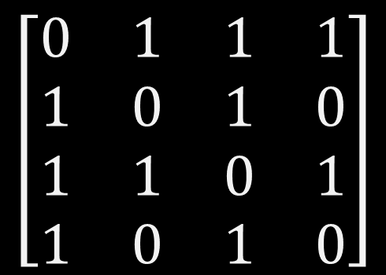
ADJACENCY MATRIX
The adjacency matrix of an unweighted graph contains only 0 and 1. $M_{u,v}=1$ if there is an edge going from node $u$ to node $v$, $M_{u,v}=0$ otherwise.
A
$$\begin{matrix}A & B & C & D\end{matrix}$$
$$\begin{matrix}A \\ B \\ C \\ D\end{matrix}$$
$$\left[\begin{matrix}0 & 1 & 1 & 1 \\ 1 & 0 & 1 & 0 \\ 1 & 1 & 0 & 1 \\ 1 & 0 & 1 & 0\end{matrix}\right]$$
B
D
C
Notes:
When considering unweighted graph, The adjacency matrix contains only 0 and 1. $M_{u,v}=1$ if there is an edge going from node $u$ to node $v$, $M_{u,v}=0$ otherwise.

Slide 19
ADJACENCY MATRIX
The adjacency matrix of an unweighted graph contains only 0 and 1. $M_{u,v}=1$ if there is an edge going from node $u$ to node $v$, $M_{u,v}=0$ otherwise.
A
$$\begin{matrix}A & B & C & D\end{matrix}$$
$$\begin{matrix}A \\ B \\ C \\ D\end{matrix}$$
$$\left[\begin{matrix}0 & 1 & 1 & 1 \\ 1 & 0 & 1 & 0 \\ 1 & 1 & 0 & 1 \\ 1 & 0 & 1 & 0\end{matrix}\right]$$
B
D
C
In the case of an undirected graph, the matrix $M$ is symmetric, that is $M_{u,v}=M_{v,u}.$
Notes:
In the case of an undirected graph, the matrix $M$ is symmetric, that is $M_{u,v}=M_{v,u}.$

Slide 20
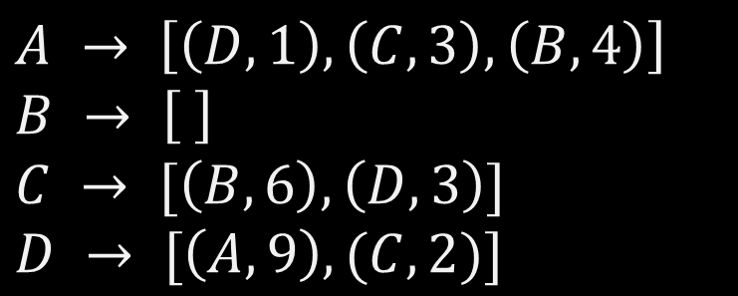
ADJACENCY LIST
An adjacency list represents a graph as a map from nodes to their lists of edges.
9
A
D
1
$$A → \left[\left(D,1\right),\left(C,3\right),\left(B,4\right)\right] \\ B → \left[ \right] \\ C → [\left(B,6\right),\left(D,3\right)] \\ D → [\left(A,9\right),(C,2)]$$
3
4
3
C
2
B
6
Notes:
A better alternative to the edges list is the adjacency list. An adjacency list represents a graph as a map from nodes to their lists of edges.

Slide 21
ADJACENCY LIST
An adjacency list represents a graph as a map from nodes to their lists of edges.
9
A
D
1
$$A → \left[\left(D,1\right),\left(C,3\right),\left(B,4\right)\right] \\ B → \left[ \right] \\ C → [\left(B,6\right),\left(D,3\right)] \\ D → [\left(A,9\right),(C,2)]$$
3
4
3
C
2
B
6
For each node we track only the outgoing edges. In the case of node $C$, we only have to track the outgoing edges $\left(C,B,6\right)$ and $(C,D,3)$.
Notes:
In this representation, a node only keeps track of its outgoing edges. An outgoing edge of node u is an edge where u is the source. In the case of node $C$, we only have to track the outgoing edges $\left(C,B,6\right)$ and $(C,D,3)$.
Note that the node B does not have any outgoing edges, and therefore the node B is mapped to an empty list.

Slide 22
Pros & Cons
 | Edge List | Adjacency Matrix | Adjacency List
Space
Edge weight lookup
Iterating over all edges
Notes:
As I said earlier, it is important to understand the different data structures used to represent a graph, and especially knowing which data structure will be more suitable for your problem. To this end we will be comparing each data structure against three dimensions:
The space needed to store the graph
How efficient it is to find the weight of an edge or if it exists
An finally, Iterating over all the edges of a graph, a task that many algorithms need to perform

Slide 23


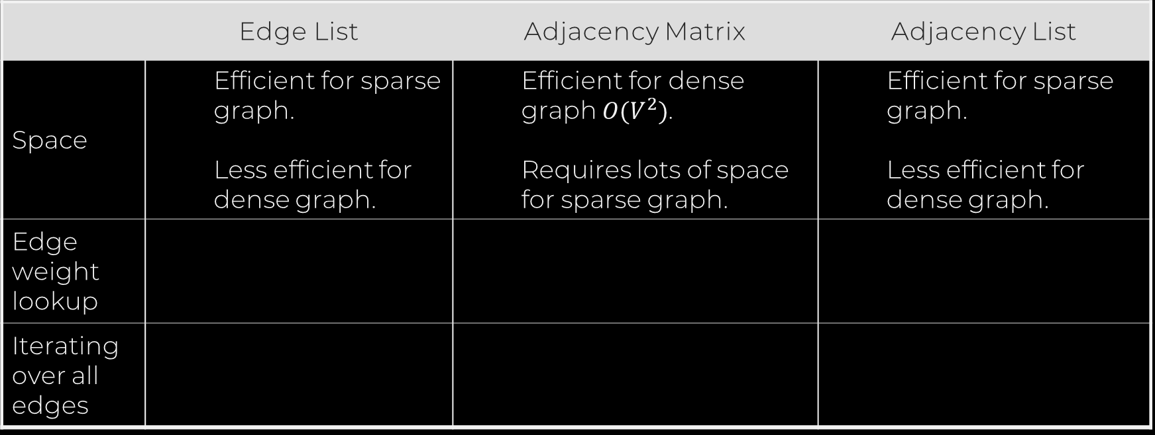
Pros & Cons
 | Edge List | Adjacency Matrix | Adjacency List
Space | Efficient for sparse graph. Less efficient for dense graph. | Efficient for dense graph $O(V^{2})$. Requires lots of space for sparse graph. | Efficient for sparse graph. Less efficient for dense graph.
Edge weight lookup
Iterating over all edges
Notes:
When considering the space used to store a graph, the edges list and the adjacency list perform better on sparse graphs. For example, a graph of a thousand nodes requires a matrix of a million cells.
On the other hand, if on average each node as a degree of 10, that is the node has around 10 incoming and outgoing edges, we need to store only five thousand pairs of values. Less than one percent of the matrix is used to store useful information, the remaining 99 percent is just a waste of space.
However, if the graph is dense, then the number of edges is of the order of a million and storing a million pairs of values in a list become far less efficient than a matrix.

Slide 24
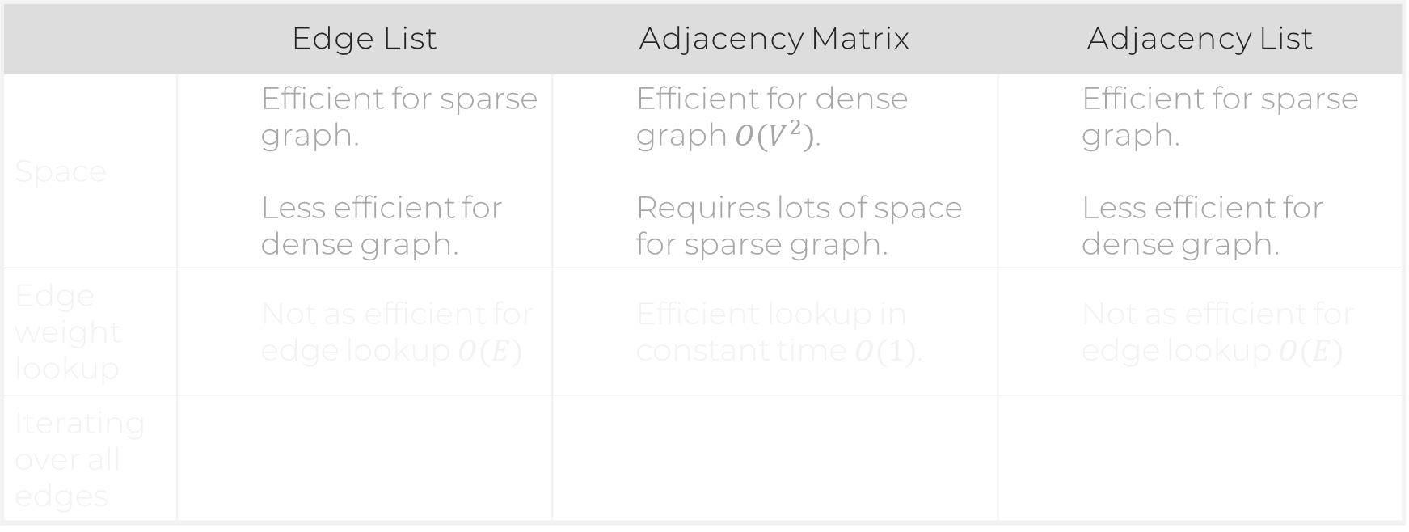
Pros & Cons
 | Edge List | Adjacency Matrix | Adjacency List
Space | Efficient for sparse graph. Less efficient for dense graph. | Efficient for dense graph $O(V^{2})$. Requires lots of space for sparse graph. | Efficient for sparse graph. Less efficient for dense graph.
Edge weight lookup | Not as efficient for edge lookup $O(E)$ | Efficient lookup in constant time $O(1)$. | Not as efficient for edge lookup $O(E)$
Iterating over all edges
Notes:
To find the weight of an edge, adjacency matrix are extremely performant. We say it is in constant time which means in layman term that it is almost instantaneous to retrieve the value whatever the size of the graph.
On the other hand, using adjacency list or edges list means than we need to traverse the list until we find the edge of interest before being able to return the weight of the edge. We say it is linear with respect to the number of edges E. In other words, in the worst possible case, the edge is the last one on the list and we have to look at all the edges before finding the one of interest. The more edges on the graph, the less performant is the lookup operation.

Slide 25
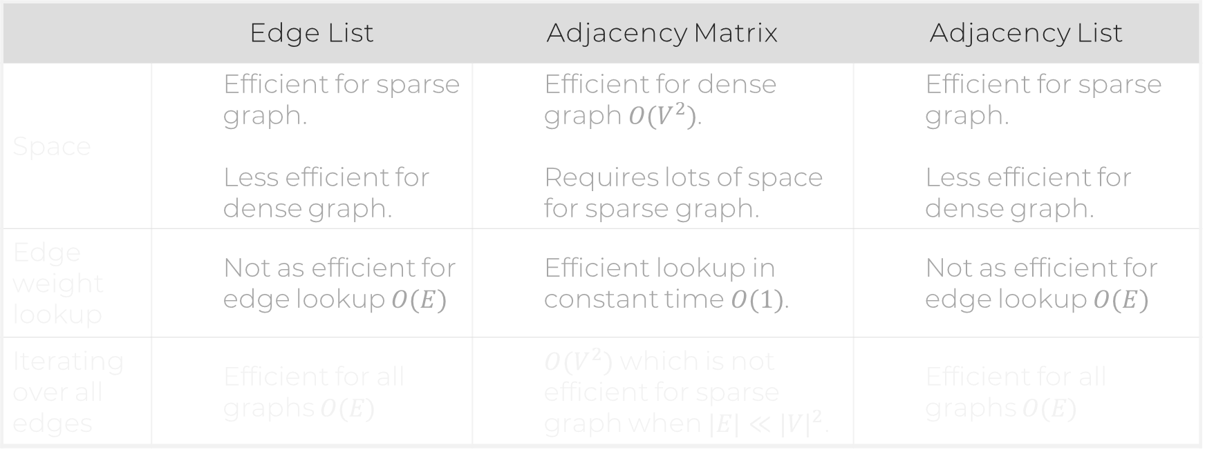
Pros & Cons
 | Edge List | Adjacency Matrix | Adjacency List
Space | Efficient for sparse graph. Less efficient for dense graph. | Efficient for dense graph $O(V^{2})$. Requires lots of space for sparse graph. | Efficient for sparse graph. Less efficient for dense graph.
Edge weight lookup | Not as efficient for edge lookup $O(E)$ | Efficient lookup in constant time $O(1)$. | Not as efficient for edge lookup $O(E)$
Iterating over all edges | Efficient for all graphs $O(E)$ | $O(V^{2})$ which is not efficient for sparse graph when $|E|≪{|V|}^{2}$. | Efficient for all graphs $O(E)$
Notes:
Finally, iterating over all edges is more efficient using edge list or adjacency list. It is particularly true for sparse graph. Again, considering a graph of a thousand nodes containing around five thousand edges, it will require to visit all one million cells of the adjacency matrix. The difference in performance is less of an issue for dense graphs.
Now that we have a good idea of what graphs are and how to represent them, we will be able to explore some of the many problems that can be solved using graphs.

